Slide 1
Navigating Rock Updates: A Step-by-Step Guide
Best Practices and Tips

Slide 2
Takeaways
https://college-church.org/rx24

Slide 3
Who is this presentation for?
New to Rock
Mitigate Risk
Step by Step Update Process
Notes:
New to Rock – What does it look like to update Rock, what is involved?
Rock is somewhat unique compared to other SASS offerings in that it is always hosted/self hosted so you are always directly or indirectly responsible for managing the upgrade process

Slide 4
Why present on this topic?
No current recipes or best practices
Limited documentation
Notes:
Why did I decide to present on the topic?
No recipes or best practices publicly available that discuss this topic in detail
Limited documentation available and reading the documentation isn’t enough to ensure consistent positive results, “Once you decide you’re ready, simply click the Install button and Rock will do the rest.”
Give Rock owners greater confidence and perspective on the overall update process

Slide 5
Rock Documentation on Updating 📕
Start with the manual

Slide 6
Agenda - Navigating Rock Updates: A Step-by-Step Guide
WHEN
WHY
HOW
STEP BY STEP
TROUBLESHOOTING

Slide 7
WHEN

Slide 8
When can I update?
Early Access vs General Access

Slide 9
Early Access
Rock powers churches and churches power Rock.
Access to all major Rock releases one year before each general release
Suggested donation rate per organization is $4.10 USD per average attendee per year
Small and new ministries can apply for a grant
Notes:
As an acknowledgement of the incredible support offered by the organizations that donate at or above our minimum suggested amount, we offer them access to all major Rock releases one year before each general release.
This tiered release will also help many community leaders get up to speed on all the latest features before each general release, which will keep our community support options consistent and high quality.

Slide 10
General Access
For organizations who contributing below the suggested value
Access to all major Rock releases one year after each general release

Slide 11
Update Planning
Selecting an update frequency
Selecting an update window
Preparing to update
Research
Test
Change Log
Arranging Support
Notes:
Goal:
Minimize Risk and Actual Issues
Prepare staff and highlight how Rock is adding value

Slide 12
Selecting an update frequency
Collaborative decision between you and leadership team
They’re probably to ask for a list of options
differentiate expectation for major, security, issue
As with other projects we can adjust
Time, Cost, Scope
Rock’s Recommendation For Security Related Patches
“Always ensure you are running on the latest secure version or higher”
Notes:
They may completely offload the decision-making process to you
Time: How much of our time are we going to spend researching, testing, executing an update?
Cost: are we going engage outside resources for assistance
Scope: are we just pushing update or are we implementing new features, how extensive will our testing be?
Unfortunately it is rather difficult to assess the severity of a Rock Security Patch because specific details are not published which document what security flaw is being addresses in each patch
This is the price we pay for some level of security through obscurity, that being the case it is in our best interest to update asap as we work with this known unknown

Slide 13
Selecting you update window
This will varying from church to church
Factors
Peak staff usage
Peak congregant usage (Events, Event Registration, Giving)
System Backups
Support Availability (Community, Consultants)
Typical Windows
Early Morning (6-8 AM)
End of Work Day (4-6 PM)
Night Shift (8-10 PM)
Notes:
There is no perfect window

Slide 14
WHY

Slide 15
Why update?
Security Releases
Bug Fixes
New Features
Perspective shift from “Have to” to “Get to”
To update is to serve the community
Notes:
Being a part of the Rock community
Accessibility. Community. Craftmanship. Innovation.

Slide 16
HOW

Slide 17
HOW
Goal: Minimize Risk & Maximize Impact
Prepare
Preview
Test

Slide 18
HOW: 1) Prepare
Research
What is included in the update?
How will this update affect our current implementation of Rock?
Existing Features (Configuration, Training, Documentation)
New Features (Implementation or Training)
Are there any updates we as a church:
Specifically requested
Should notify internal/external users
Require more investigation
Initiate training and discussions with necessary teams
Notes:
Lead in You need to ask questions like?
Initiate Training and Discussions with respective teams

Slide 19
Researching
Read and summarize findings from various resources
Connect with community and support resources
Key Question: “What are you hearing about release X”?
Notes:
If you don’t already have one, find a buddy

Slide 20
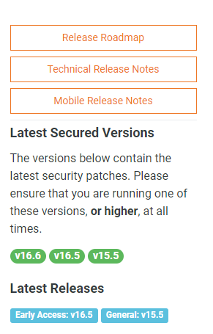
Release Resources
https://www.rockrms.com/Rock/ReleaseNotes
Release Roadmap
Key Additional Resources
Obsidian Conversion
Impact Statistics
Rock Community
Blog
Podcast
GitHub Search
Search Rock Chat
Partners
Notes:
The obsidian-block-release contains key details about Rock’s transition from webforms to obsidian. You want to test and possibly do some retraining around these blocks as you update.
Impact Statistics can you assess risk as you update because you track how many organizations are running a specific Rock Instance
Assess the size of the risk, early adopters always have more risk to unknown risks
Subscribe to the blog via “rock radar” https://www.rockrms.com/rock-radar
Rock Chat is one of the key tools I use for addressing known risks

Slide 21
Obsidian Block Conversion

Slide 22
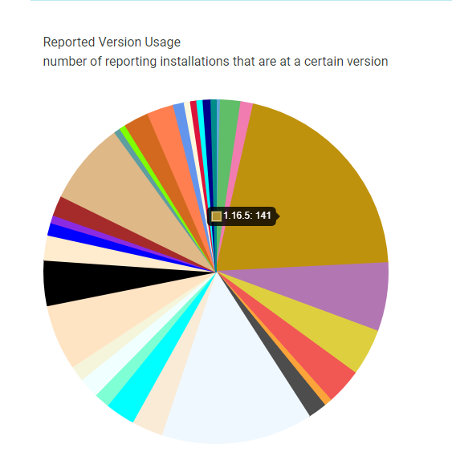
Impact Statistics

Slide 23
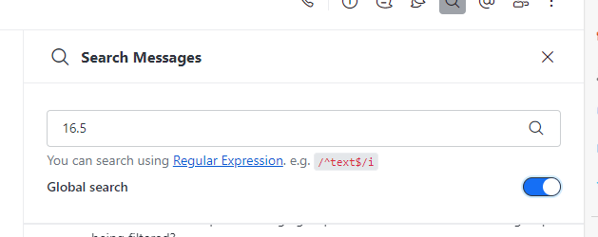
Rocket Chat

Slide 24
Hotfixes – Looking Ahead

Slide 25
GitHub Search – Label Search
Notes:
Looking to ahead to understand what is broken and will be fixed
If I am updating to 16.5, I want to understand if 16.5 specifically introduced any new issues
I can do that by looking at the bug fixes included in 16.6 through 17.0
I can also use GitHub to check on the status of any bugs that I have submitted

Slide 26
GitHub Search – Author Search
Notes:
Looking to ahead to understand what is broken and will be fixed
If I am updating to 16.5, I want to understand if 16.5 specifically introduced any new issues
I can do that by looking at the bug fixes included in 16.6 through 17.0
I can also use GitHub to check on the status of any bugs that I have submitted

Slide 27
GitHub Search – Author & Label Search
Notes:
Looking to ahead to understand what is broken and will be fixed
If I am updating to 16.5, I want to understand if 16.5 specifically introduced any new issues
I can do that by looking at the bug fixes included in 16.6 through 17.0
I can also use GitHub to check on the status of any bugs that I have submitted

Slide 28
Documentation Change Log

Slide 29
Major Release Resources
Update Videos (Featured in the Community Blog)
Documentation Change Log

Slide 30
HOW: 2) Preview Sandbox
Cost For Upgrade Only Focused Sandbox ($20-$25/month)
Manage Costs (Scaling DTUs \ Sleeping VMs)
Setting Up A Sandbox
Rock Solid Azure Hosting
Rock Solid Internal Hosting
Community
Consider Sandbox Refresh

Slide 31
Refreshing a Rock Development Environment from Production
https://community.rockrms.com/recipes/355/refresh-a-development-server-in-azure
https://community.rockrms.com/recipes/352/refreshing-a-rock-development-environment-from-production
https://rockrms.blob.core.windows.net/documentation/PDFs/Creating_a_Sandbox.pdf
https://community.rockrms.com/get-involved/role/alpha-beta-testers

Slide 32
HOW: 2) Preview other options
Demo site (https://rock.rocksolidchurchdemo.com/)
Community members

Slide 33
HOW: 3) Test
Testing starts with building a test plan
Document with your team what features you will test every update
Profile Page
Check-in via the Check-in Client
Online Giving
Each Login Authentication Method Each Site
Event Registration
Document a list of release specific tests

Slide 34
Alpha/Beta Team Testing
Alpha Bet Test List
~200+ specific test cases as well as categories for consideration

Slide 35
Update and Sandbox Environment
Run documented tests
Invite staff to use sandbox and test

Slide 36
STEP BY STEP

Slide 37
CCIW STEP BY STEP
Research
Sandbox Update (2 week out)
Pre-Update Tasks (1 week out)
Pre-Update Tasks (day of)
Update
Test

Slide 38
1. Research
Release Notes
Release Roadmap
Key Additional Resources
Obsidian Conversion
Impact Statistics
Rock Community
Notes:
The obsidian-block-release contains key details about Rock’s transition from webforms to obsidian. You want to test and possibly do some retraining around these blocks as you update.
Impact Statistics can you assess risk as you update because you track how many organizations are running a specific Rock Instance
Assess the size of the risk, early adopters always have more risk to unknown risks
Subscribe to the blog via “rock radar” https://www.rockrms.com/rock-radar
Rock Chat is one of the key tools I use for addressing known risks

Slide 39
2. Sandbox Update (2 week out)
Review state of plugin Updates
Optionally sandbox refresh from production
Not restricted to specific time-window
Update sandbox using a copy production update procedure
Run “every update” as well as version specific tests
Explore new features function using our data
Using public demo site and connecting with community as necessary
Notes:
Optionally refresh from Production (doing a refresh from production will help minimize Risk because you are testing out the update on an exact copy of your database/webserver files)

Slide 40
3. Pre-update tasks (1 week out)
Notify staff
Preparing future maintenance notifications/pages
Notes:
Notify staff when Rock will be updated, what maintenance window will be and provide a short description of what will be changing
Video is a good format for the what will be changing content especially when core pages are undergoing a significant change

Slide 41
4. Pre-update tasks (day of)
Post notification popup
Print off / generate checklist
Send staff wide reminder remail
Check for and warn internal users 10 mins prior to update
Notes:
Popup notification is turned on an off and updated via global attributes

Slide 42
Pop Up Notification
Notes:
Only displays once if they click dismiss

Slide 43
Update to staff

Slide 44
5.Update Tasks – Part A
Verify Azure Backup are happening
Disable in Azure Mgmt. Plugin to ensure database scaling will not take place during update
Remote Connect to Production VM
Rename app_offline-inactive.htm to app_offline.htm and verify the site is offline
Wait 10 minutes to ensure a transaction log backup occurs
Stop IIS Webserver
Delete Avatar Cache
Backup wwwroot folder

Slide 45
5.Update Tasks – Part A
Rename app_offline to bring the site back
01
Resize Azure SQL Server to 400 DTU (2-3 Minutes)
02
Enable Cloudflare Caching Development Mode
03
Purge Cloudflare Cache for college-church.org
04
Restart IIS
05

Slide 46
5.Update Tasks – Part B Repeat Per Each Dot Release
Document the number of service jobs
Admin Tools > General Settings > Rock Update
Click Install on the oldest update 🥳
Once the “Eureka” screen loads up, wait till
Web server CPU and ISS Worker return to baseline
version specific jobs complete
Compute Utilization returns to baseline
Click Restart Button
Notes:
Oldest update, update from the bottom of the list
I always do each update one at a time so I can pinpoint what update caused an issue if necessary

Slide 47
5.Update Tasks – Part B Repeat Per Each Dot Release
Perform Basic Testing
Review Profile Page
View and login/logout of our external site
Navigate to Internal Login Page and Review
Logout/login
Repeat Step B for each dot release (i.e. 16.4, 16.5…)

Slide 48
5.Update Tasks – Part C – Post Updates
Install Plugin Updates
Stop IIS
Backup wwwroot folder
Start IIS
Reenable Azure Mgmt. Plugin
Turn off site notifications
Disable Cloudflare Caching Development Mode
Resize Database decreasing DTUs

Slide 49
6. Test
Follow your test plan and document test results
Prioritize critical rock functionality first
Invite staff feedback

Slide 50
Quick Reminders on Testing
Testing starts with building a test plan
Document with your team what features you will test every update
Profile Page
Check-in via the Check-in Client
Online Giving
Each Login Authentication Method Each Site
Event Registration
Document a list of release specific tests

Slide 51
Learning how to run updates
The Five Steps of Leadership Development
I do. You watch. We talk.
I do. You help. We talk.
You do. I help. We talk.
You do. I watch. We talk.
You do. Someone else watches.
Notes:
If you want to learn or teach someone else how to run updates follow the The Five Steps of Leadership Development
Ask a support partner to train you
Ask to community if you can tag along while someone else installs an update

Slide 52
TROUBLESHOOTING

Slide 53
If it all goes sideways…
Start by
Taking a deep breath and pray
Don’t go it alone, grab a coworker, contact a support partner, reach out the community
Troubleshooting Resources
What to do when things go wrong
Additional Tip: Check the browser console window
https://www.triumph.tech/videos/triumphant-problem-solving

Slide 54
Takeaways
https://college-church.org/rx24

